Slide 1
NPC FW
Control Algorithms
PREPARED BY
Joey De Guzman
Firmware engineer
Lite-On Singapore
1-Nov, 2022

Slide 2
Overview
A. Introduction to classical PFC control
B. Control state machine
Zero crossing offset auto-calibration
Relay enable
Closed loop softstart for bulk voltage
Recoverable OVP for bulk voltage
PWM enable at zero crossing
NPC rectifier sequence
NPC inverter sequence
C. PID controller and PWM generation
Sine PWM, average line current control
Midpoint voltage balancing
PWM blanking for 5% duty and below
Synchronous rectifier control for NPC rectifier

Slide 3
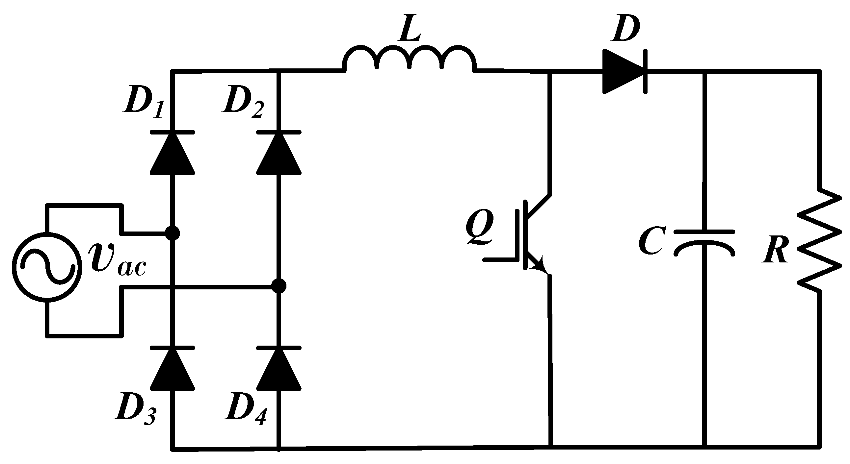
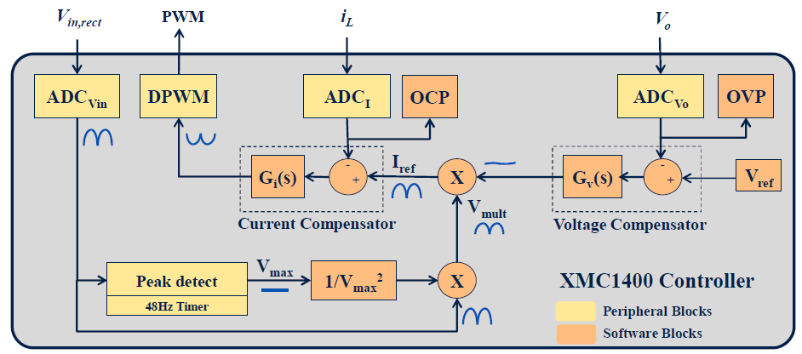
Introduction to classical PFC control
[3]
Current compensator
Current reference feedforward
Voltage compensator
A classical PFC control is a cascaded voltage compensator and current compensator. Output voltage is regulated while also doing power factor correction.
Input to the controller are line voltage, line current, and output voltage, output to the controller is PWM.
Digital PFC control diagram

Slide 4
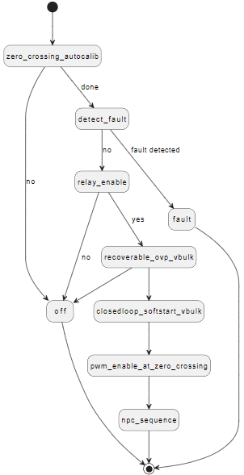
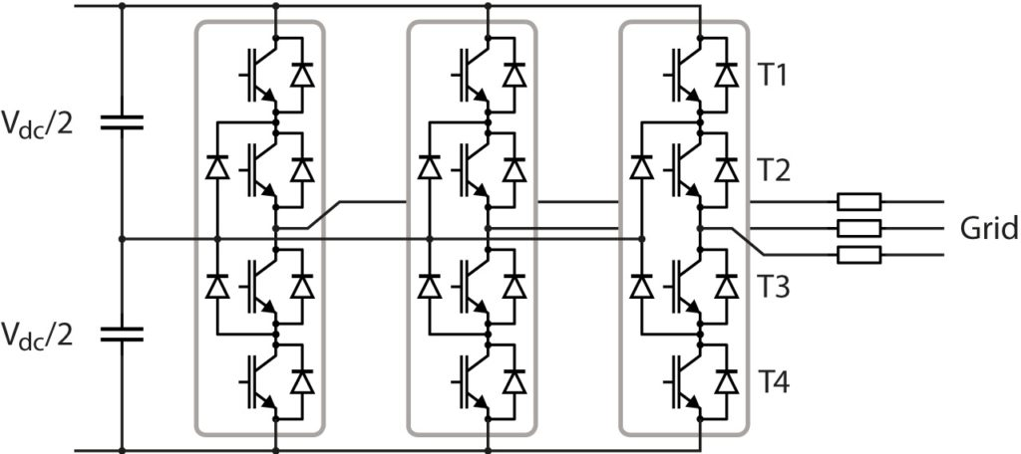
Control state machine
Initial routines: zero crossing auto-calibration, detect fault, relay enable.
Steady-state routine: recoverable OVP for vbulk, closed loop softstart for vbulk, PWM enable at zero crossing
Turn off routines: fault and OFF
Three phase NPC
Plant UML URL:
https://www.plantuml.com/plantuml/uml/VP7HJiKW38Rl-nHScvmNs8Kvxs5Cmw0eaL64CZEVNWyGdJbkTxJ_zpLDkHRHMUeIuDLRKhGasPIbOh9FuZd2qyEpkbmUrITbHfEv51zVK5TXeuEVuQ3V74j2Hj3f6cHIbYETukpSf283xBsMZ0czqLEozrYce3UagET0VTA-Cn33A-LRZRmcNESQtYQrKRbZV_VvLsg82Lp81kQ4XPsqO_RuIEfp0GxDpgIFPQo2Ml3FrG1EmYR7PB3GUwLe261VtTBl7mKOHnibE_VplbAqTGbV

Slide 5
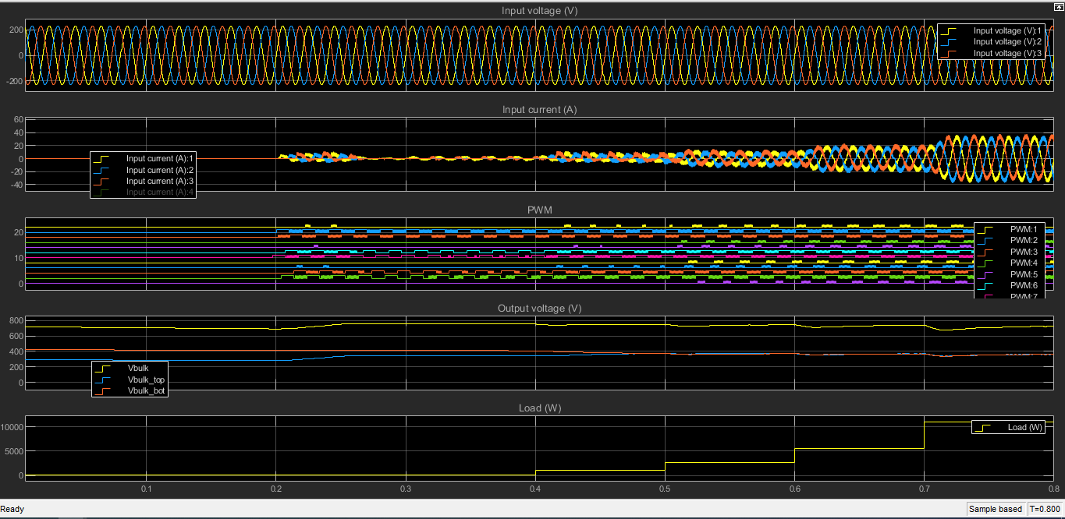
Control state machine
Input: 280Vrms, 50Hz. Dynamic load regulation from 1%, 10%, 25%, 50%, 100%.
Input AC voltage
Power factor
correction
PWM following
NPC sequence
Midpoint voltage balancing
Dynamic loading

Slide 6
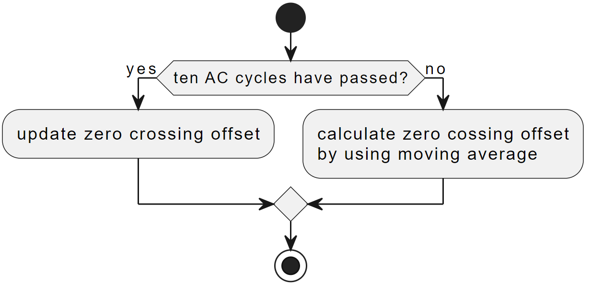
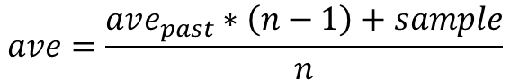
Zero crossing offset auto-calibration
Optimized moving average equation:
$$ave=\frac{ave_{past}∗\left(n−1\right)+sample}{n}$$
Plant UML URL:
https://www.plantuml.com/plantuml/uml/LOuz3i8m38Ltd-ADxHLWe8Xhi8JKQIkbSHKxbShfCLqGat_yoUyRr4ArjcOw6w8beJCkk3yGZvXPCOUTiGLL7cyzRFPZTx3s15pQDWPZlBaAOXNLfKoGb9JjIfoLqHKvoHXoRFa7_x7FyZhGpiKg-xTuPWqJ-vCoBedSJZOQV73L3m00

Slide 7
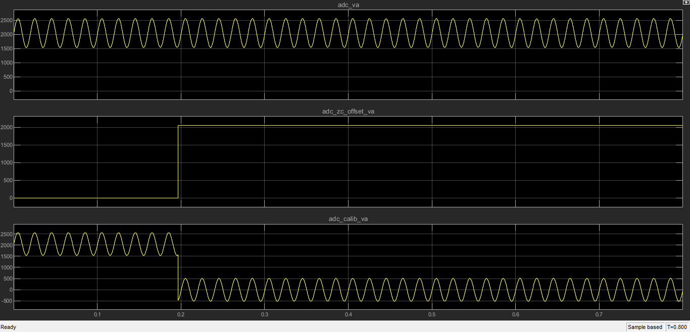
Zero crossing offset auto-calibration
AC signal directly from ADC,
Uncalibrated AC signal
Zero crossing auto-calibration done
after 10 cycles of input AC voltage
Calibrated AC signal
Uncalibrated AC signal

Slide 8
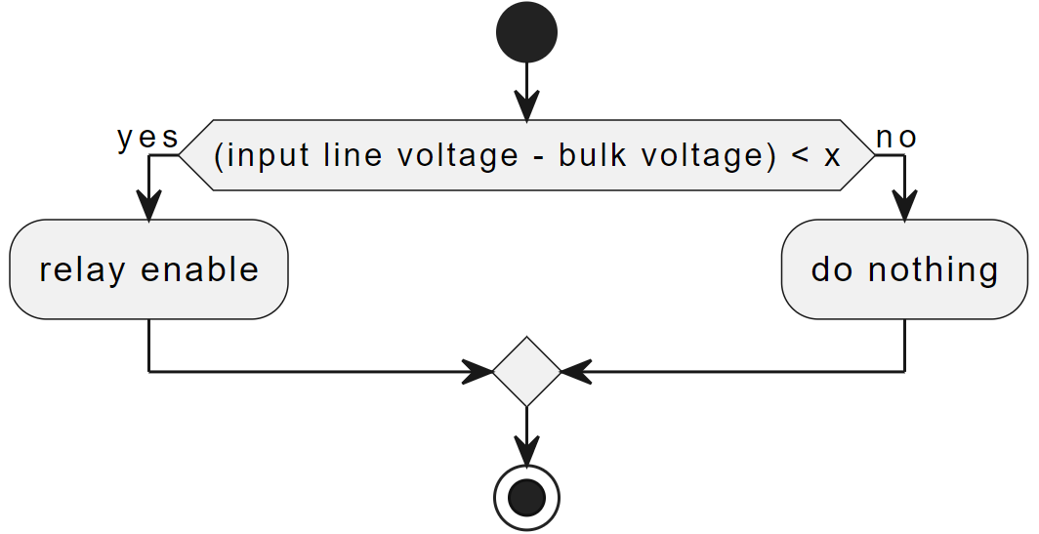
Relay enable
Plant UML URL:
https://www.plantuml.com/plantuml/uml/DOqn3i8m34Ltd-AFoS05WA5NILMtjJ1srJY8tfue4jjxUiERQfGpsbjf096iI4diQ04LOtnSesoC6-QchxzcFF7DY9qDwUAQ2RYVhEK2MvcL7yHQ6SbyfCLX7hlOreCjibB_-K5Jbpx_0G00

Slide 9
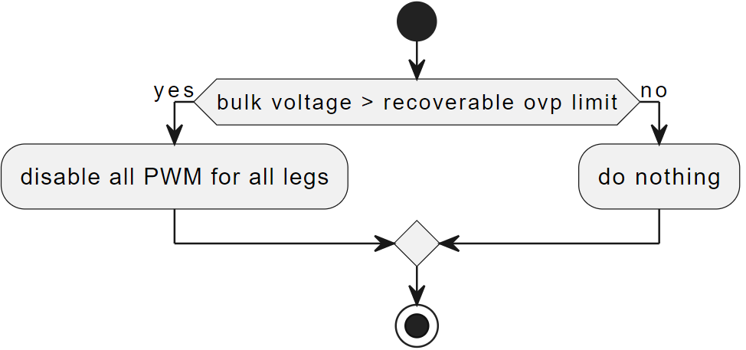
Recoverable OVP for bulk voltage
Plant UML URL:
https://www.plantuml.com/plantuml/uml/9Sf1heCm38JXlKynIxZ2UrB51IfrrtKe1goQ6CLEfDw-ADtze_acZrIY7aezY6J5C5Tzevb6sXWt57vPuv9cPLWxeN98Z8YTCuOF-qZ0toBUGLB5utd7QgMtykR_nEgC8TkF6hB5BdcxZhp8IkHX9qtNg8T-0G00

Slide 10
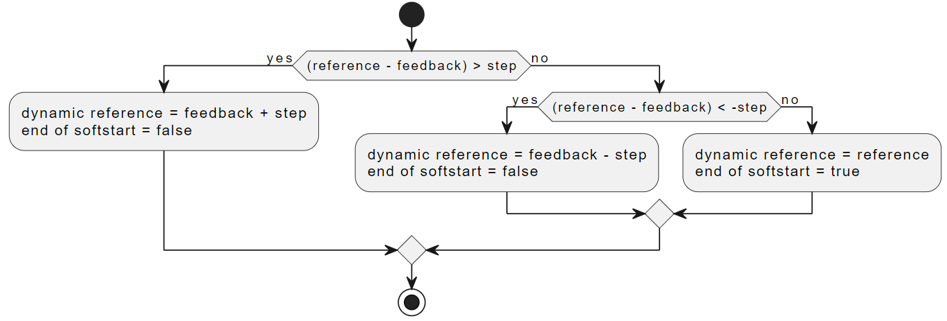
Closed loop softstart for bulk voltage
Plant UML URL:
https://www.plantuml.com/plantuml/uml/XP0x3eCm44JxFSMKHX4No2VY86aSl5PGO8syIy7jmqSY3GdDQ2nvthDSgVbiGzVIKeYQ2ESoHyuiDQD4P0vFNxyBtA76VG5xiS2Dh0K1vp2AxveQtyrjs-2qJ1x24f0YD4LRFFCTtofVYAU4apIp_hYlA7VaH_hoK0zi3_ZDs_ekoVAmWYGqaTOajTHJDHsch_q0

Slide 11
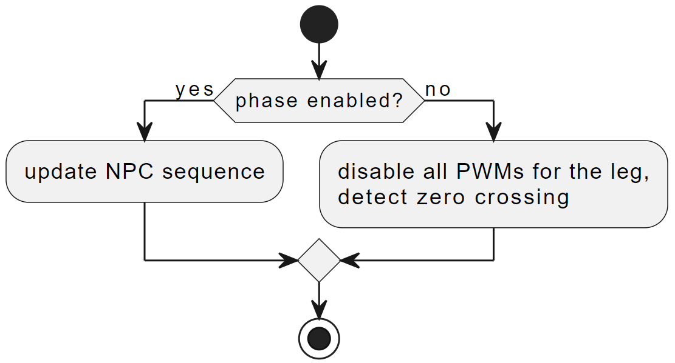
PWM enable at zero crossing
Plant UML URL:
https://www.plantuml.com/plantuml/uml/7Oun3i8m54FtVmgFhSG9w40bPb0t5fRGk6say5Foqm5EJzhDbloirrjnkMplA4SG2HEQTN56KDqhqbzQb8MAvajh1JXlgtU5k0zN63yRTMGdZ9LeD1qB7sn7uMB4yBWPffJt4qJEfwTw5eu5F-Q4CIUpe7CdL1ycgHffbRwMwlG7

Slide 12
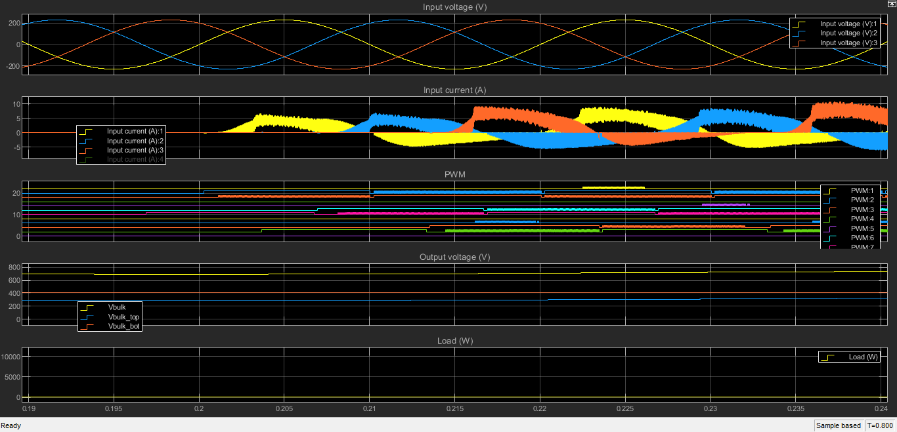
PWM enable at zero crossing
Phase A zero crossing
Phase B zero crossing
Phase C zero crossing

Slide 13
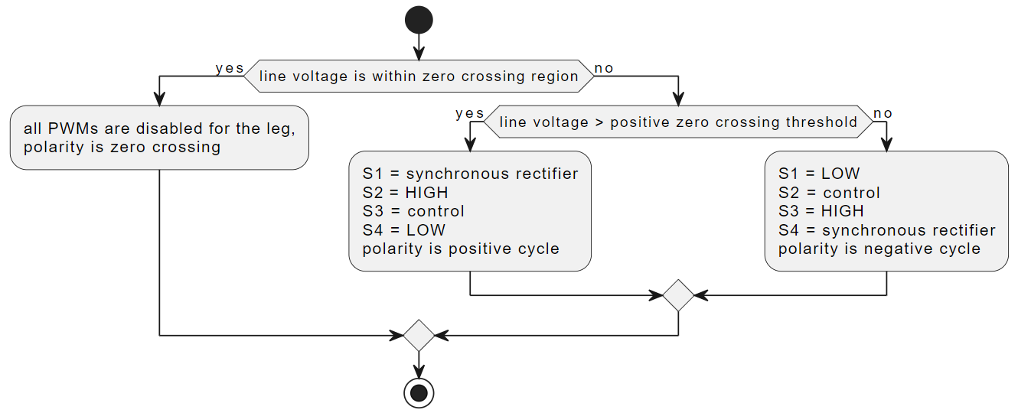
NPC rectifier sequence
Plant UML URL:
https://www.plantuml.com/plantuml/uml/TP51IyD048Nl-olcc88NRKyMfJShA0ezzDBBkfaa0-DCcDbMugzteuUGI2_XFRBxlGzsvpbQFdzo-0qXK0CLao1Sb7Di4SZXYt970jze2idKdQG5mvPKLf0x5AW6z5K0k8_Cy7vyTOY6K9F73yOQ6hNn732sDoVfbQDH7Wfwpjm6P4UeH4VMFvD7wDKfqmKNAhapz4wvNjWKdyCjF80FaZfJqRE3OShK4Df93dVbt_xvQL_YkiIaaasvj4rfBs_7cUeqdeR4k2tyoNRQ6gyLyWotddOsLtLcMu9jN6n9JKtu-mRFseTTAUNXVW00

Slide 14
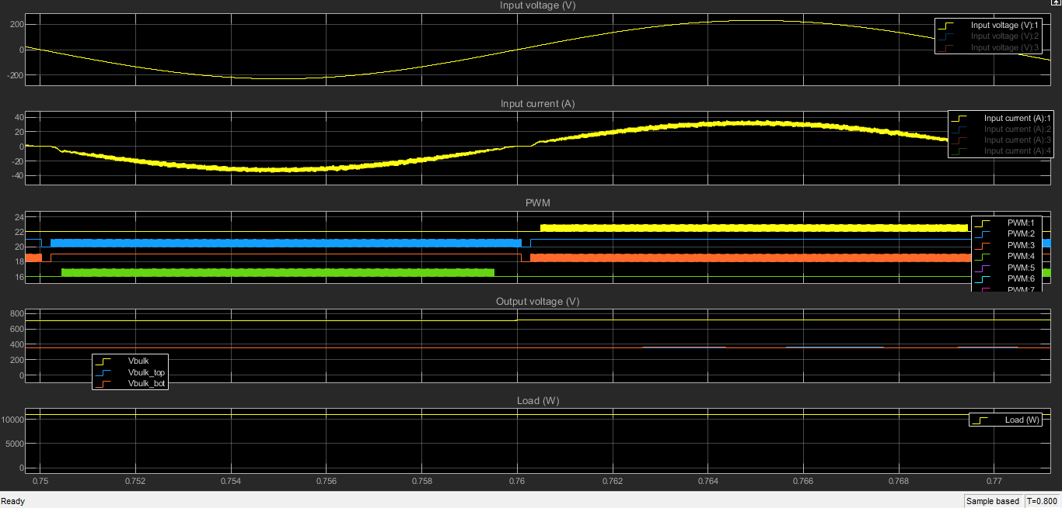
NPC rectifier sequence
Polarity is negative
Polarity is positive
Polarity is zero crossing

Slide 15
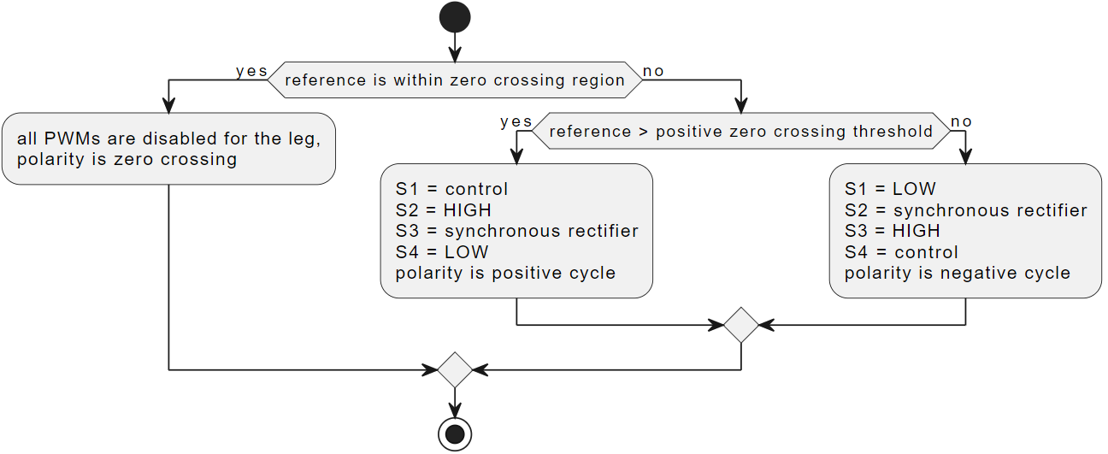
NPC inverter sequence
[1]
Plant UML URL:
https://www.plantuml.com/plantuml/uml/VP6nJiD038RtUmgFgSG2xKG5waQHG21rwDBbk3Y9fSEEx2ieF3qE3D5rw1BzbkFl_wJRMObQpfyv_8KGg8D6iKD5JWXay4rb88OVL86aOaRSWs9FmYie0p8q4zeg0Dp7dE7z-6eG5Q4bYnyPM-X4v_yWOtzpub5oL2gJeslcDc0sX8PbPjKQZp2AKQ4lh6-SgsY3vFP2nMKEj_00IRYev1CVxdpQFp_jFQuzsiHfK64v6oYcGXsX-cxZkvUtO-MvbASfPTmwVr5Tklnixha2NoyEcqMkxcBiuqKNjzI5_s-m8cFO-U1FzWi0

Slide 16
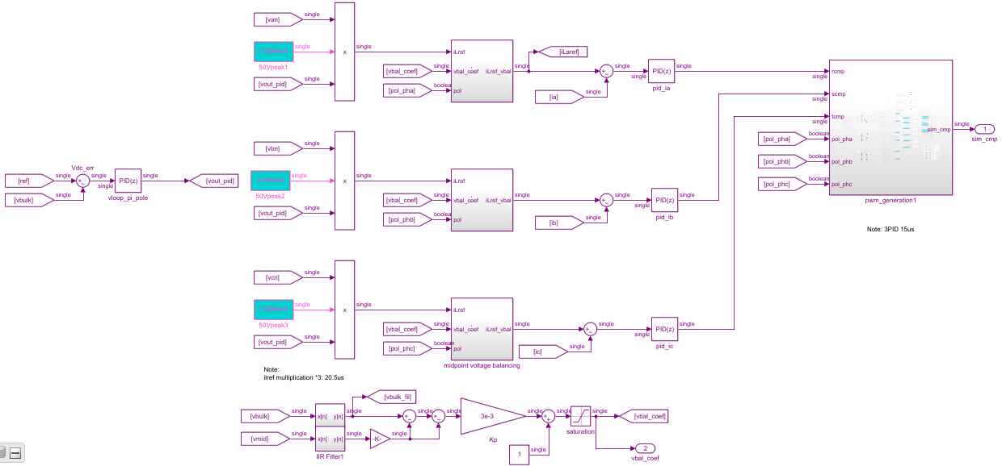
Sine PWM, average line current control

Slide 17
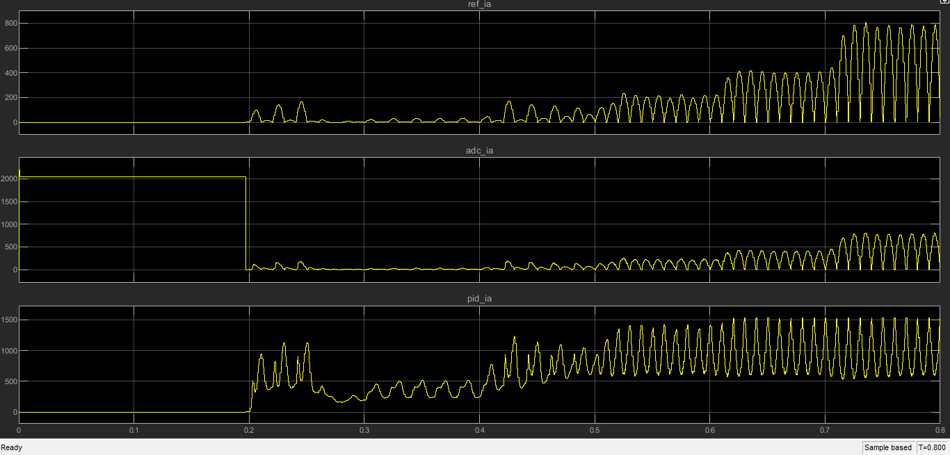
Sine PWM, average line current control
Reference for line current phase A
Feedback for line current phase A
PI Output for phase A

Slide 18
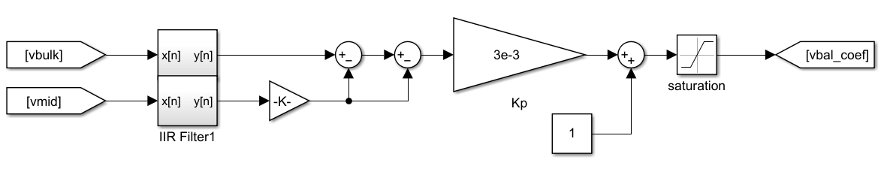
Midpoint voltage balancing
Need to balance the top
and bottom cap

Slide 19
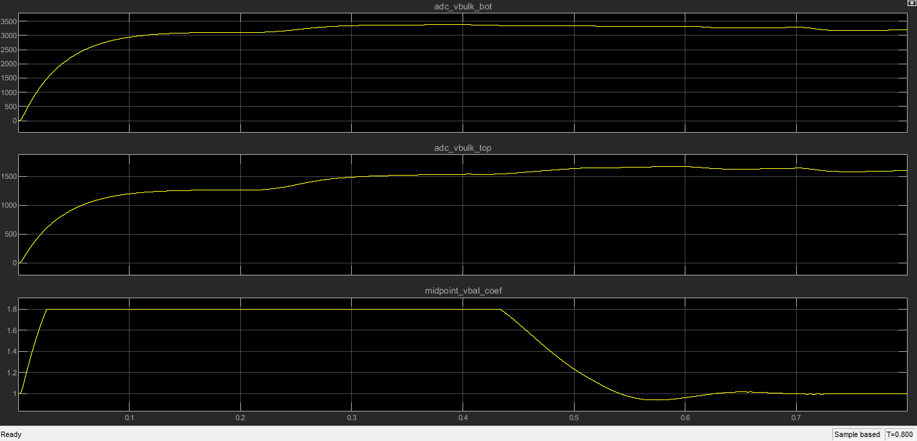
Midpoint voltage balancing
Bottom cap voltage
Top cap voltage
Initially, bottom cap is dominating
the midpoint voltage balancing
Midpoint voltage balancing action

Slide 20
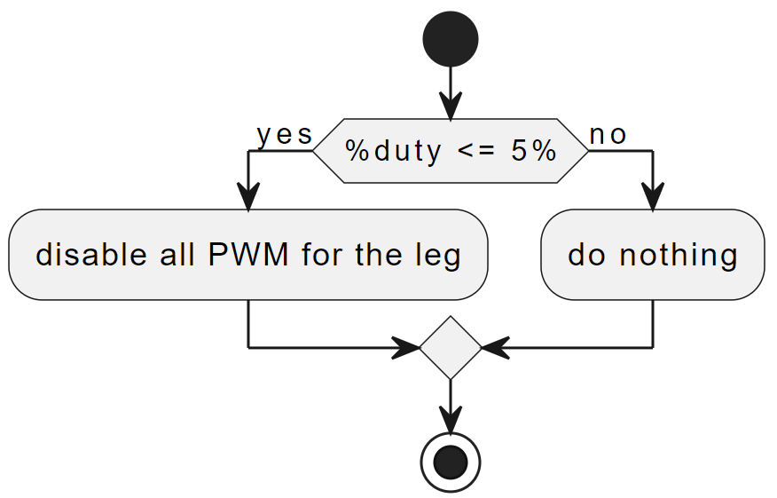
PWM blanking for 5% duty and below
Plant UML URL:
https://www.plantuml.com/plantuml/uml/9Oqx2iD034HxdM8Qm_e0QV81No2GBlM6rSOBYXGikV3jiuwx6Tw3Dtda9TQFq7yGjOeqb3KsN6yu3IDYPaNQs4S2pgLvVWaZY-3nlAFQiXiGVb-8nHb9xJ0DQZ4ttO6MLgadx4jJFxtt0m00

Slide 21
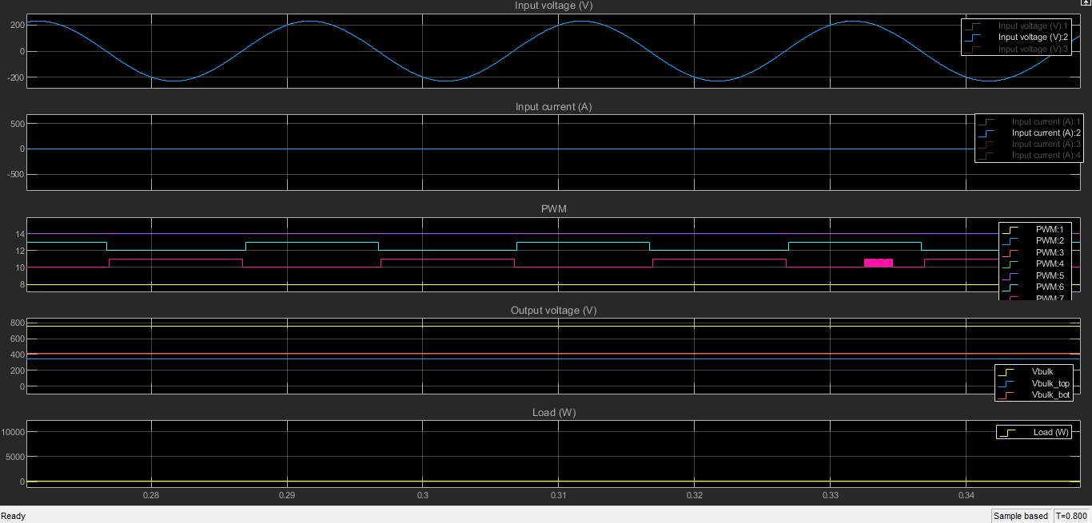
PWM blanking for 5% duty and below
%Duty is zero
%Duty is zero

Slide 22
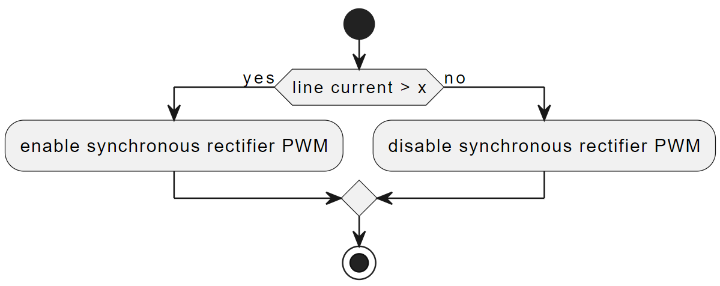
Synchronous rectifier control
[2]
Plant UML URL:
https://www.plantuml.com/plantuml/uml/9Oqx2iD034HxdM8Qm_e0QV81No2GBlM6rSOBYXGikV3jiuwx6Tw3Dtda9TQFq7yGjOeqb3KsN6yu3IDYPaNQs4S2pgLvVWaZY-3nlAFQiXiGVb-8nHb9xJ0DQZ4ttO6MLgadx4jJFxtt0m00

Slide 23
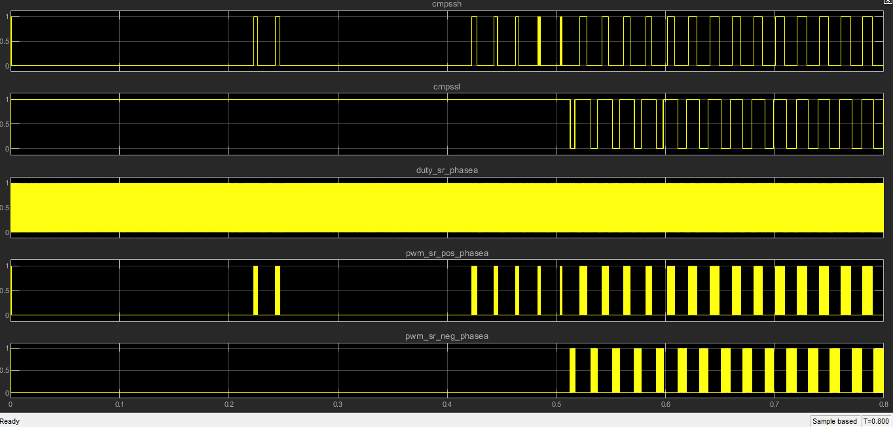
Synchronous rectifier control
SR PWM output

Slide 24
Reference
[1] Staudt, I. (2015). 3L NPC & TNPC Topology. https://www.semikron.com/dl/service-support/downloads/download/semikron-application-note-3l-npc-tnpc-topology-en-2015-10-12-rev-05/
[2] Sun, B. (2017). Control challenges in a totem-pole PFC. https://www.ti.com/lit/pdf/slyt718
[3] Valascho, R., & Abdel-Rahman, S. (2016). Digital PFC CCM boost converter. https://www.infineon.com/dgdl/Infineon-Digital+PFC+CCM+Boost+Converter+-+300W+Design+Example+Using+XMC+1400-AN-v01_00-EN.pdf?fileId=5546d462584d1d4a015886d4dcaa5ea4

Slide 25
Thank You
Connect with LITEON

